Slide 1

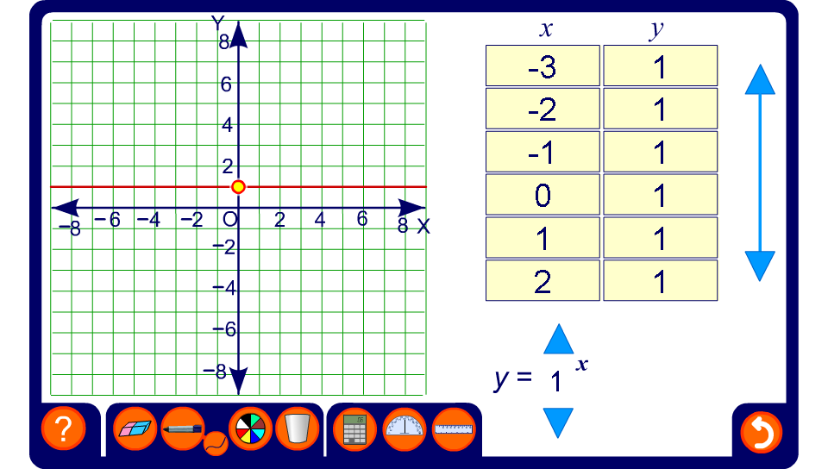


Exploring exponential graphs
Notes:
Modify the graph and observe what happens to the curve.
Note that all of the graph will always pass through the point (0, 1) and ask pupil to give you the reason for this.
Establish that when a is greater than 0 the graph shows an exponential increase for positive values of x. When a is between 0 and 1, the graph shows an exponential increase for positive values of x. Ask pupils to explain why the graph will never touch the x-axis.

